Slide 1

Population Genetics
Workshop #3
Please sign in & grab a sandwich from Mendocino Farms!!
Introduce yourself to others - how has the quarter been so far?

Slide 2
Population Genetics Background
What is Population Genetics?
> Analyzing DNA Sequences among a large population of individuals
Why is it worth studying?
> Enables us to better understand the relationship between evolution and genetic variation
> Potential Applications: Studying drug resistance, species migrations, ancestry, personalized medicine, forensics

Slide 3
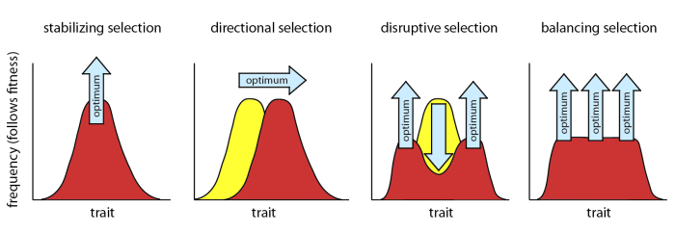
Population Genetics Background
Drivers of Genetic Diversity
> Mutations
> Genetic Drift
> Fluctuations of allele frequencies
> Selection
> Gene Flow
> Introducing new genetic material through admixture
Notes:
Genetic Drift: : Fluctuations of allele frequencies
Gene Flow Introducing new genetic material through admixture

Slide 4
Tools for Population Genetics
Genome-Wide Association Study (GWAS)
Decode what genes are associated with higher risk of disease, and how different genes can work together leading towards complex traits
Can be used to identify correlations between ethnic groups and disease risk
Don’t always work → need to pay attention to population structure!
Principal Component Analysis (PCA)
Taking multi-dimensional data and transforming it to be linear, allowing us to subsequently cluster DNA samples
Represents populations numerically, then we can reimplement into GWAS

Slide 5
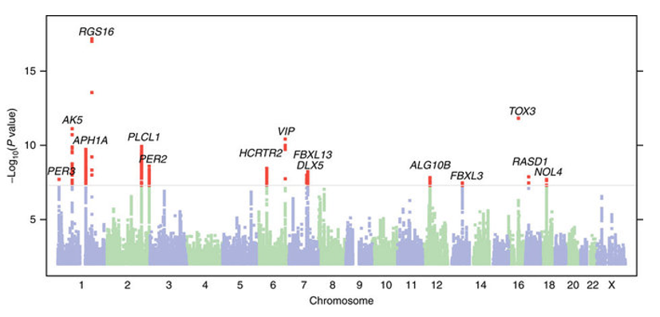
Associating Genetic Variation with Phenotypes via GWAS

Slide 6
Linear Algebra Review, Brief
Matrix multiplication
Dot Product
Transpose
Eigenvectors
Eigenvalues

Slide 7
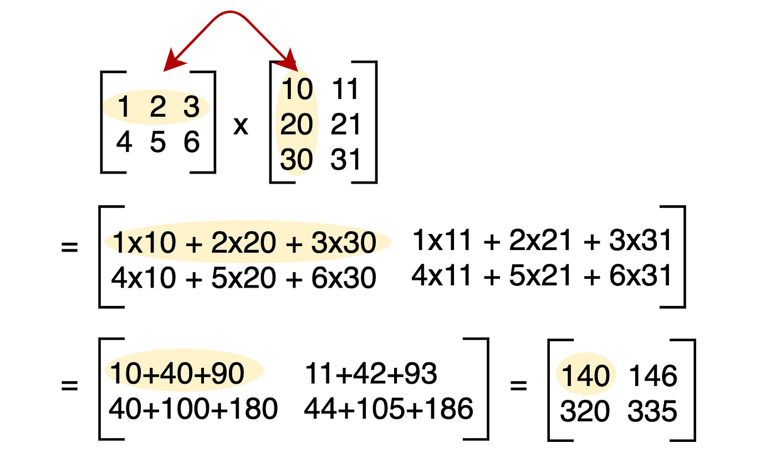
Matrix Multiplication
For mat(a) * mat(b) = mat(c)
c will have row count of a and column count of b
to be able to multiply matrices correctly the column of a and the rows of b must be equal

Slide 8
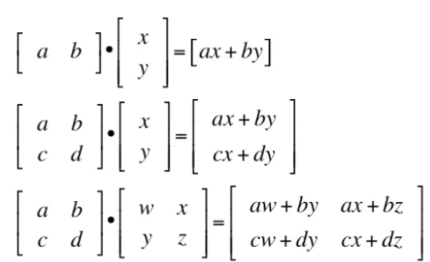
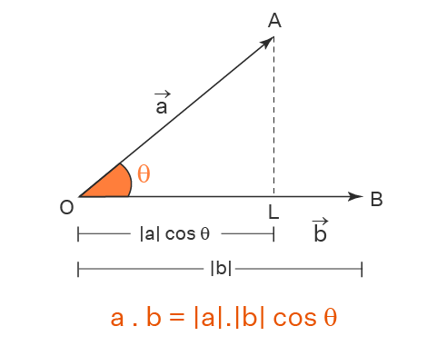
Dot Product

Slide 9
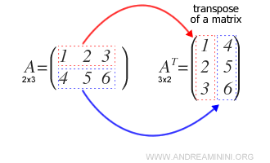
Transpose Matrix
Flip the original matrices rows with its columns to derive the transpose of a matrix

Slide 10
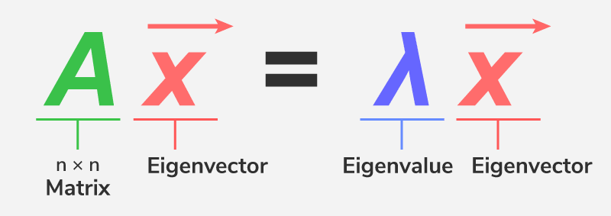
Eigenvectors & Eigenvalues
Eigenvector:
Nonzero Vector v in such that Av=λ, for some scalar λ
Eigenvalue:
Scalar value that makes it so Av=λv has non trivial solution

Slide 11
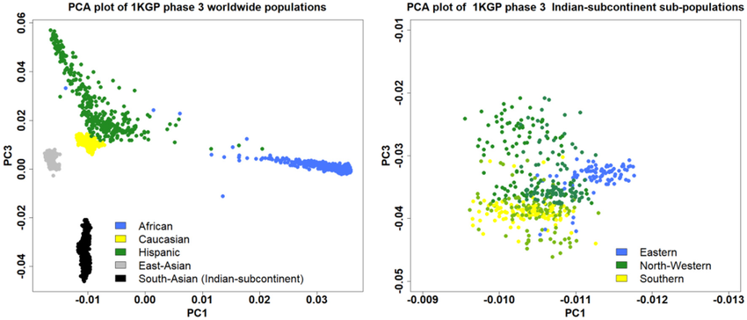
Understanding PCA Plots

Slide 12
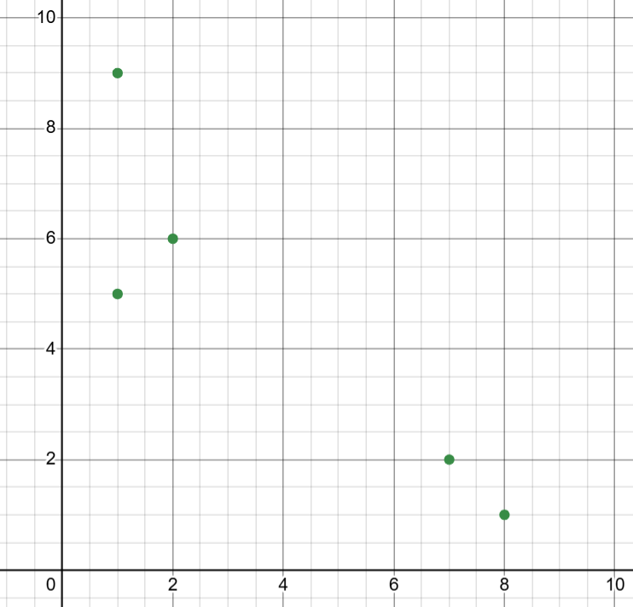
Understanding PCA Plots
Two measures of transcription
 | Subject 1 | Subject 2 | Subject 3 | Subject 4 | Subject 5
Gene 1 | 7 | 8 | 2 | 1 | 1
Gene 2 | 2 | 1 | 6 | 9 | 5

Slide 13
Understanding PCA Plots
Three measures of transcription
 | Subject 1 | Subject 2 | Subject 3 | Subject 4 | Subject 5
Gene 1 | 7 | 8 | 2 | 1 | 1
Gene 2 | 2 | 1 | 6 | 9 | 5
Gene 3 | 16 | 17 | 59 | 47 | 39
Third axis
Bigger dots are closer (on third axis)

Slide 14
Understanding PCA Plots
More measures of transcription!
 | Subject 1 | Subject 2 | Subject 3 | Subject 4 | Subject 5
Gene 1 | 7 | 8 | 2 | 1 | 1
Gene 2 | 2 | 1 | 6 | 9 | 5
Gene 3 | 16 | 17 | 59 | 47 | 39
Gene 4 | 100 | 101 | 3 | 2 | 1
?

Slide 15
Understanding PCA Plots
More measures of transcription!
 | Subject 1 | Subject 2 | Subject 3 | Subject 4 | Subject 5
Gene 1 | 7 | 8 | 2 | 1 | 1
Gene 2 | 2 | 1 | 6 | 9 | 5
Gene 3 | 16 | 17 | 59 | 47 | 39
Gene 4 | 100 | 101 | 3 | 2 | 1
?
PCA plots can take more measurements and create a 2D plot to show how subjects cluster
& which gene is most valuable for clustering

Slide 16
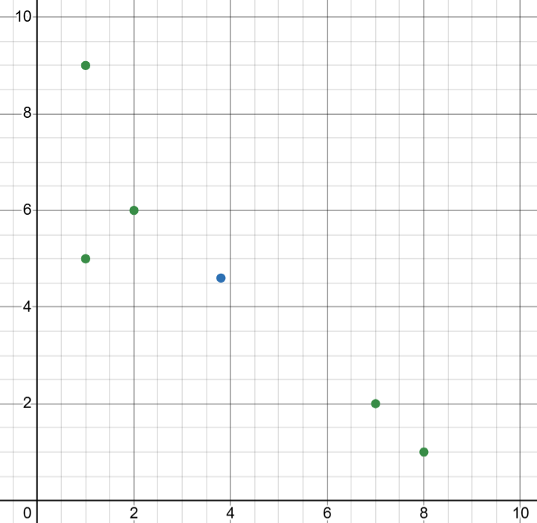
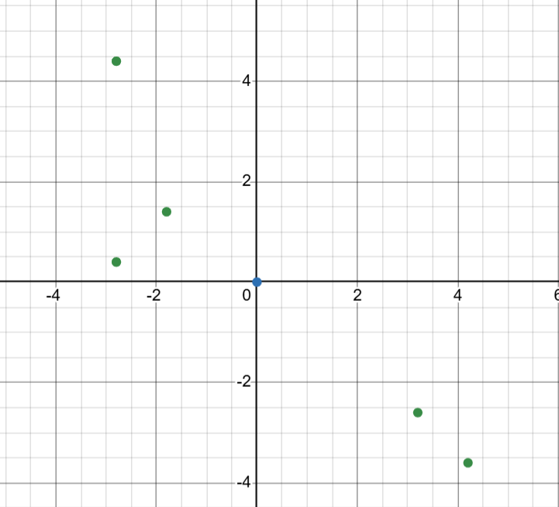
Understanding PCA Plots
Gene 2
Gene 2
(avg x, avg y)
Gene 1
Shift to make graph center around averages
Gene 1

Slide 17
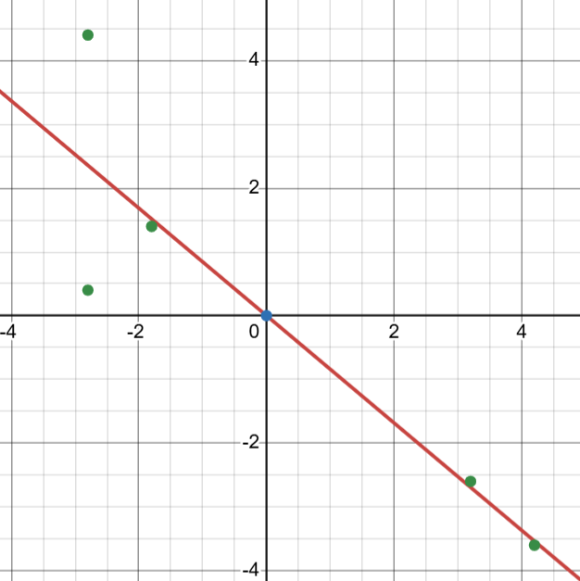
Understanding PCA Plots
Gene 2
Next, draw line and rotate it until PCA determines a line of best fit
Gene 1

Slide 18
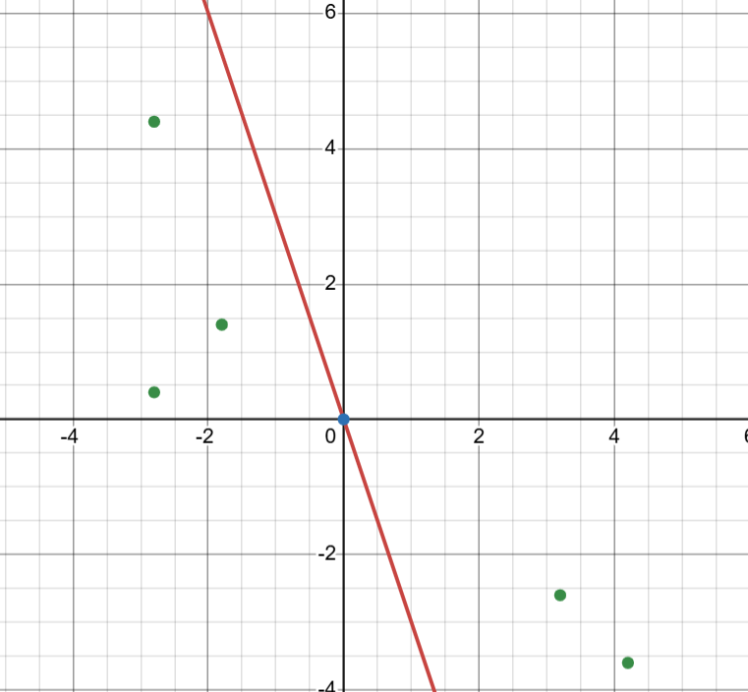
Understanding PCA Plots
Gene 2
Next, draw line and rotate it until PCA determines a line of best fit
For PCA to determine which line fits best, each point is projected onto the line and keeps track of each projected point’s distance to origin
Gene 1
b
a⋅b
Keeps track of distance to origin
a

Slide 19
Understanding PCA Plots
Gene 2
Next, draw line and rotate it until PCA determines a line of best fit
For PCA to determine which line fits best, each point is projected onto the line and keeps track of each projected point’s distance to origin
Each distance is squared and summed together to get sum of squared distances (SSD)
(d1)²+(d2)²+(d3)²+(d4)²+(d5)² = SSD
d1
d2
d3
Gene 1
d4
d5

Slide 20
Understanding PCA Plots
Gene 2
Next, draw line and rotate it until PCA determines a line of best fit
For PCA to determine which line fits best, each point is projected onto the line and keeps track of each projected point’s distance to origin
Each distance is squared and summed together to get sum of squared distances (SSD)
(d1)²+(d2)²+(d3)²+(d4)²+(d5)² = SSD
The line that produces the largest SSD will be the best scoring line to fit
d1
d2
d3
Gene 1
d4
d5

Slide 21
Understanding PCA Plots
Gene 2
The line that has the best fit is called Principal Component 1 or PC1. Its slope is -0.8419, telling us that Gene 1 is slightly more influential in describing how the data is spread
The eigenvector for PC1 can be computed by making it a unit vector
Gene 1
1
1.3072
0.7650
1
-0.8419
-0.6440
Loading scores

Slide 22
Understanding PCA Plots
Gene 2
The line that has the best fit is called Principal Component 1 or PC1. Its slope is -0.8419, telling us that Gene 1 is slightly more influential in describing how the data is spread
The eigenvalue for PC1 can be computed by getting the average of the sum squared distances (SSD)
SSD for PC1/(n-1) = eigenvalue for PC1
Gene 1

Slide 23
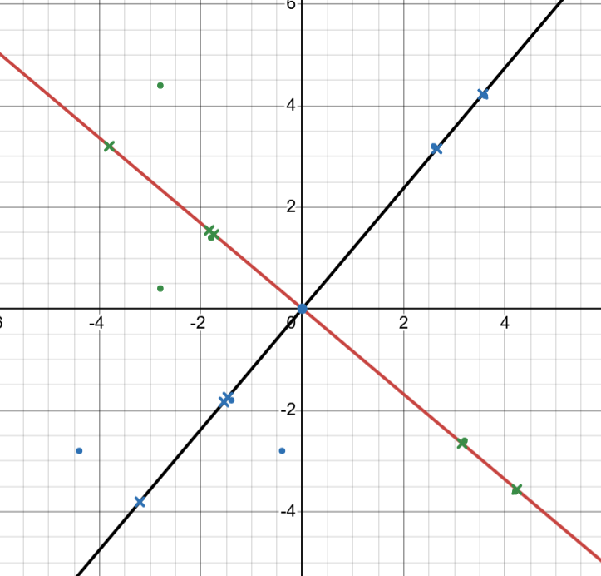
Understanding PCA Plots
Gene 2
The line perpendicular at the origin to PC1 is PC2, the slope for PC2 is -1/(slope of PCA). This means for PC2, Gene 2 is more influential than Gene 1. The eigenvalue and eigenvector is computed the same
PC1
PC2
Gene 1

Slide 24
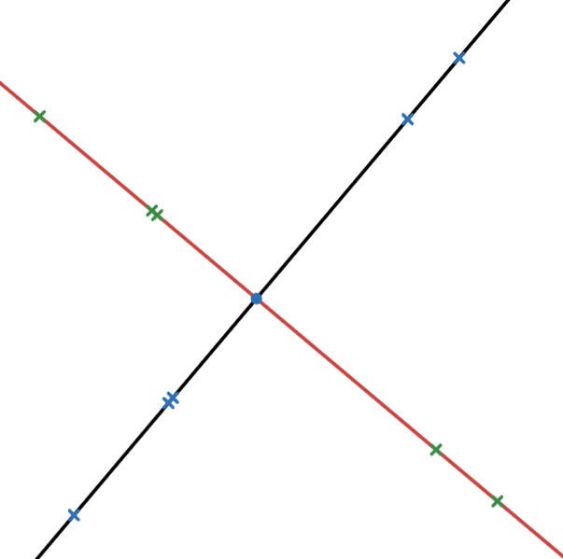
Understanding PCA Plots
PC2
The new axes become PC1 and PC2 in the final PCA plot, and the points are projected from the axes.
The eigenvalues computed for PC1 and PC2 earlier are measures for variation, and each can tell what percent of the variation each accounts for.
PC1

Slide 25
Understanding PCA Plots
Gene 2
PC2
PC3
With more genes, more axes are involved and more principal components are generated.
*Each PC is perpendicular to each other
PC1
Gene 3
Gene 1

Slide 26
Understanding PCA Plots
Gene 2
PC2
PC3
With more genes, more axes are involved and more principal components are generated.
*Each PC is perpendicular to each other
The eigenvalues for each PC can be used to determine the portion of variation each PC accounts for
PC1
Gene 3
Gene 1

Slide 27
Understanding PCA Plots
Gene 2
PC2
PC3
With more genes, more axes are involved and more principal components are generated.
*Each PC is perpendicular to each other
The eigenvalues for each PC can be used to determine the portion of variation each PC accounts for
For representation in a 2D plot, the top two PCs that account for the most variation would be used as xy axes
PC1
Gene 3
Gene 1

Slide 28
Understanding PCA Plots
PC3
The eigenvalues for each PC can be used to determine the portion of variation each PC accounts for
For representation in a 2D plot, the top two PCs that account for the most variation would be used as xy axes
If this was PC3 and PC1, the graph would look something like this
*If more than two genes accounted for much of the variation, this graph would be less accurate to representing variation
PC1

Slide 29
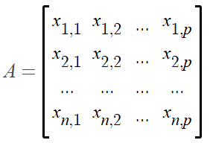
Understanding PCA Plots, with Linear Algebra
 | Subject 1 | Subject 2 | … | Subject n
Gene 1 | 7 | 8 | … | …
Gene 2 | 2 | 1 | … | …
Gene 3 | 16 | 17 | … | …
… | … | … | … | …
Gene p | 50 | 60 | 23 | 2
Represent as Matrix X

Slide 30
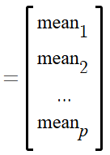

Understanding PCA Plots, with Linear Algebra
Calculate Mean of each Feature
Then center X data by subtracting mean

Slide 31

Understanding PCA Plots, with Linear Algebra
Compute the Covariance Matrix
Used to get unbiased estimate of covariance
Transpose of centered data

Slide 32
Understanding PCA Plots, with Linear Algebra
Covariance matrix is a p by p matrix, each element represents covariance between feature i and j
C_{i,i} represents variance of each feature
C_{i,j} represents covariance between different features

Slide 33


Understanding PCA Plots, with Linear Algebra
Eigenvalue decomposition of covariance matrix:
eigenvector
Solve for eigenvalues with:
eigenvalue
The eigenvalues λ_{i} tell how much variance is expressed by corresponding eigenvector v_{i}
Then plug back into decomposition for eigenvectors

Slide 34


Understanding PCA Plots, with Linear Algebra
Data points can be projected back onto PCs using the eigenvectors
For point x and eigenvector for PC1:
For all centered points and PC1:

Slide 35

Understanding PCA Plots, with Linear Algebra
The data points can be reconstructed after projection using this:
Where V_{k} is the matrix containing k eigenvectors as columns
You now have a PCA Plot!

Slide 36
Understanding PCA Plots, with Linear Algebra
Knowing this process is important to correctly using PCA plots
Normalizing/Centering Data pre processing
Interpreting variance weights of PCs

Slide 37
Genome Wide Association Studies GWAS predict which genes are correlated with a trait

Slide 38
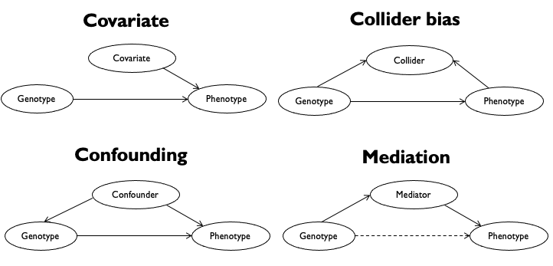
Genes are not perfect predictors

Slide 39
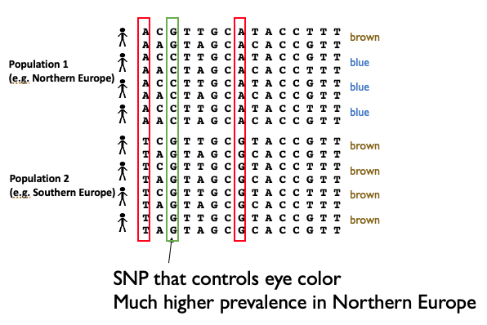
Population group is a confounding variable
Idea:
Represent population structure by the principal components.

Slide 40
Lets try it in practice:
Notebook for PCA plots

